Slide 1
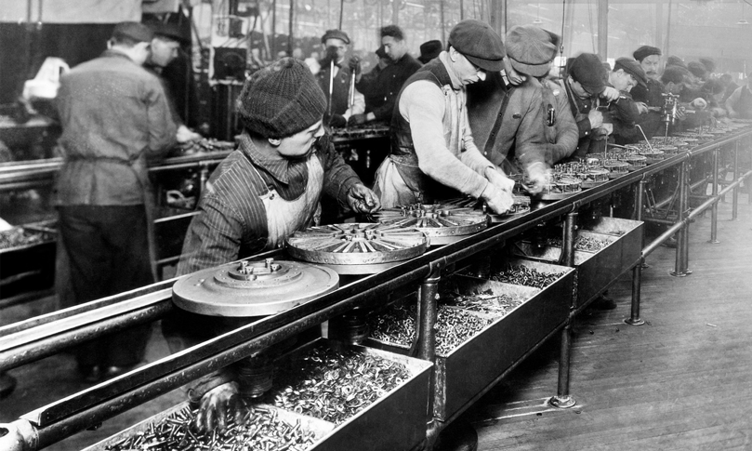
The Industrial Revolution (1750–1914)
Lesson 3 The Second Industrial Revolution

Slide 2
The Industrial Revolution (1750–1914)
Lesson 3 The Second Industrial Revolution
Learning Objectives
Describe the impact of new technology on industry, transportation, and communication.
Understand how big business emerged.
Summarize the impact of medical advances in the later 1800s.
Describe how cities changed and grew.
Explain how conditions for workers gradually improved.

Slide 3
The Industrial Revolution (1750–1914)
Lesson 3 The Second Industrial Revolution
Key Terms
Henry Bessemer
Alfred Nobel
Michael Faraday
dynamo
Thomas Edison
interchangeable parts
assembly line.
Orville and Wilbur Wright
Guglielmo Marconi
stock
corporations
cartel
germ theory
Louis Pasteur
Robert Koch
Florence Nightingale
Joseph Lister
urban renewal
mutual-aid societies

Slide 4
Science and Technology Change Industry
The first phase of industrialization was forged from iron, powered by steam engines, and driven by the British textile industry. By the mid-1800s, the Industrial Revolution was entering a new phase in which new factories powered by new sources of energy used new processes to turn out new products. At the same time, new forms of business organization led to the rise of giant new companies.

Slide 5
Science and Technology Change Industry
The Bessemer Process Transforms Steel
Innovations in Chemistry
Electricity Replaces Steam Power
Improved Methods of Production

Slide 6
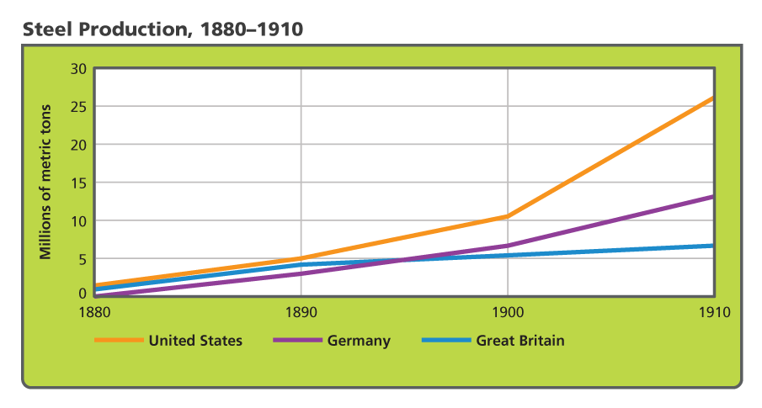
Science and Technology Change Industry
By the late 1800s, steel was the major material used in manufacturing tools. Analyze Graphs Between 1890 and 1910, which nation had the greatest increase in steel production? The smallest?

Slide 7
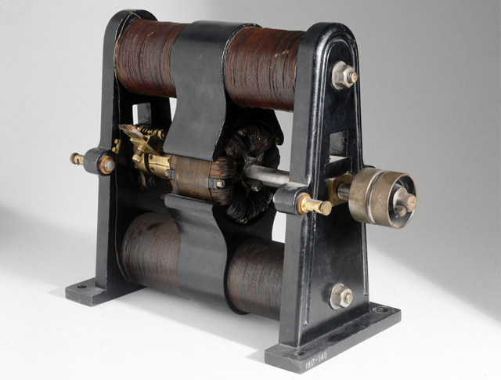
Science and Technology Change Industry
The electric dynamo, shown here, was invented by Michael Faraday in 1831. Dynamos generated the electricity used to power lights in factories and homes.

Slide 8
Advances in Transportation and Communication
During the second Industrial Revolution, transportation and communications were transformed by technology. Steamships replaced sailing ships, and railroad building took off. In Europe and North America, rail lines connected inland cities and seaports, mining regions, and industrial centers. In the United States, a transcontinental railroad provided rail service from the Atlantic to the Pacific. In the same way, Russians built the Trans-Siberian Railroad, linking Moscow in European Russia to Vladivostok on the Pacific. Railroad tunnels and bridges crossed the Alps in Europe and the Andes in South America. Passengers and goods rode on rails in India, China, Egypt, and South Africa.

Slide 9
Advances in Transportation and Communication
The Age of the Automobile
The First Airplane
A Communications Revolution

Slide 10
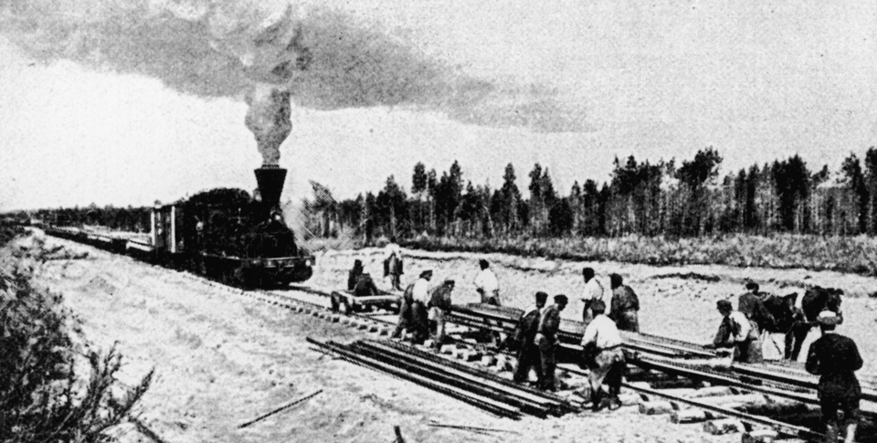
Advances in Transportation and Communication
Construction of the Trans-Siberian Railroad began in 1891. Work continued on various parts of the line until 1916.

Slide 11
Advances in Transportation and Communication
Analyze Information How did the Trans-Atlantic cable affect communications?

Slide 12
The Rise of Big Business
By the late 1800s, what we call “big business” came to dominate industry. Big business refers to an establishment that is run by entrepreneurs who finance, manufacture, and distribute goods or services on a large scale. As time passed, some big businesses came to control entire industries.

Slide 13
The Rise of Big Business
Investors Form Corporations
Monopolies Dominate Industry
Opposing Views of Big Business

Slide 14
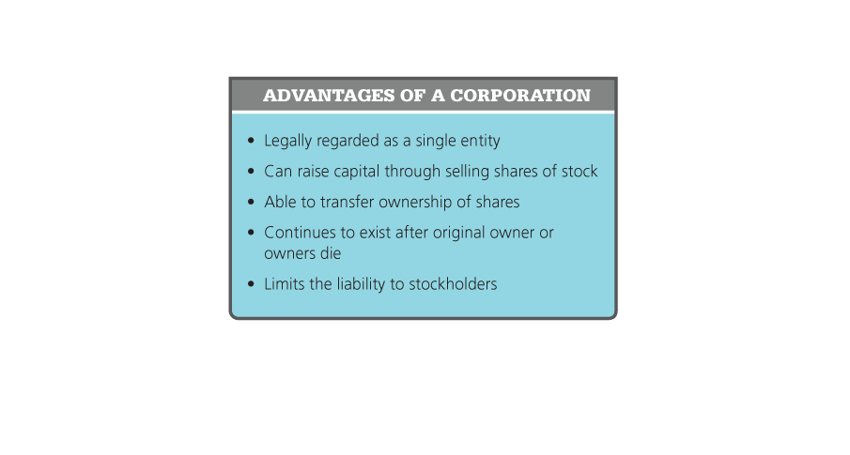
The Rise of Big Business
Corporations offered business people several advantages. Analyze Information What advantages did stockholders gain from the formation of corporations?

Slide 15
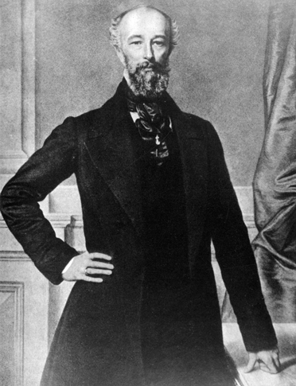
The Rise of Big Business
Alfred Krupp was the first industrialist to use the Bessemer process in Europe. Known as the 'Cannon King,' Krupp produced cast-steel cannons and other weapons of war.

Slide 16
Better Medicine, Nutrition, and Health
The population explosion that had begun during the 1700s continued through the 1800s. Between 1800 and 1900, the population of Europe more than doubled. This rapid growth was not due to larger families. In fact, families in most industrializing countries had fewer children. Instead, populations soared because the death rate fell. Nutrition improved, thanks in part to improved methods of farming, food storage, and distribution. Medical advances and improvements in public sanitation also slowed death rates.

Slide 17
Better Medicine, Nutrition, and Health
Combating Disease
Improving Hospital Care

Slide 18
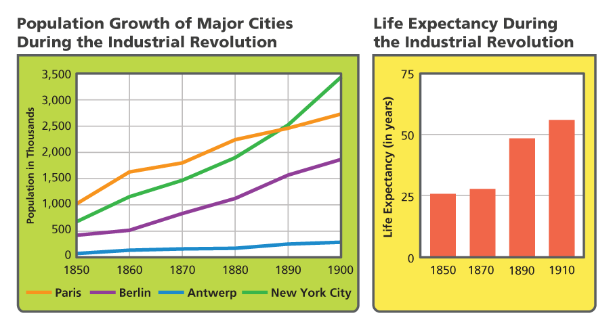
Better Medicine, Nutrition, and Health
Longer life expectancies contributed to population booms in major cities. Analyze Graphs Which city's population grew the most? How did life expectancy change between 1850 and 1910?

Slide 19
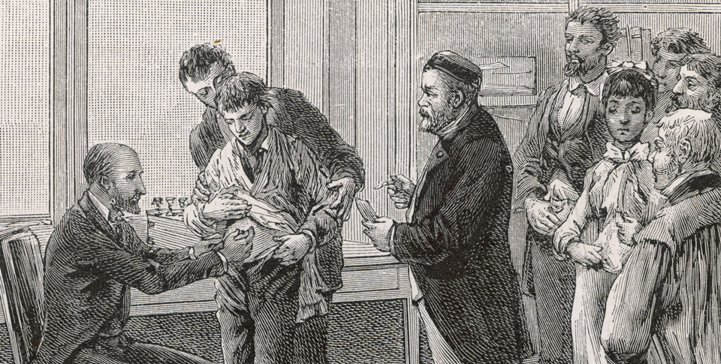
Better Medicine, Nutrition, and Health
The first person Louis Pasteur vaccinated was a nine-year-old boy named Joseph Meister, who had been bitten by a rabid dog. Meister failed to develop rabies.

Slide 20
City Life Changes
As industrialization progressed, cities came to dominate the West. Cities grew as rural people streamed into urban areas for work. By the end of the 1800s, European and American cities had begun to take on many of the features of cities today.

Slide 21
City Life Changes
New Cityscapes
Safety, Sanitation, and Skyscrapers
Life in the Slums
The Lure of City Life

Slide 22
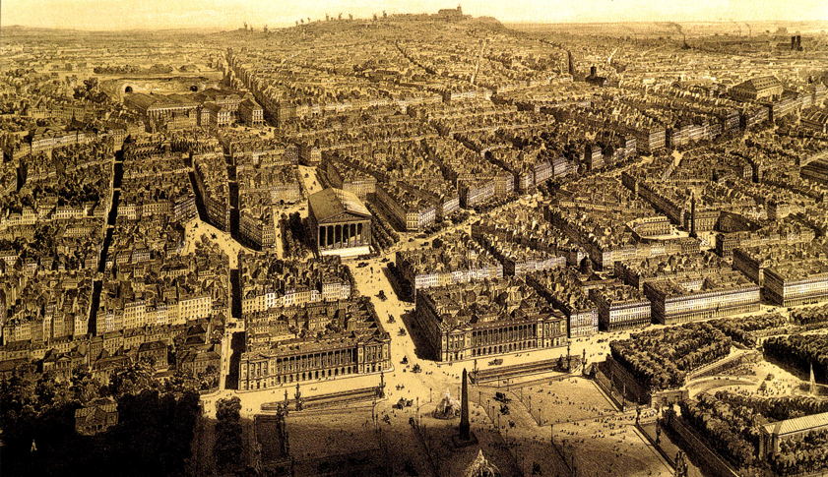
City Life Changes
This aerial view shows Paris around 1870, after being redesigned by Georges Haussmann.

Slide 23
The Working Class Wins New Rights
Workers tried to improve the harsh conditions of industrial life. They protested low wages, long hours, unsafe conditions, and the constant threat of unemployment. At first, business owners and governments tried to silence protesters. By mid-century, however, workers began to make progress.

Slide 24
The Working Class Wins New Rights
The Growth of Labor Unions
An Improved Standard of Living

Slide 25
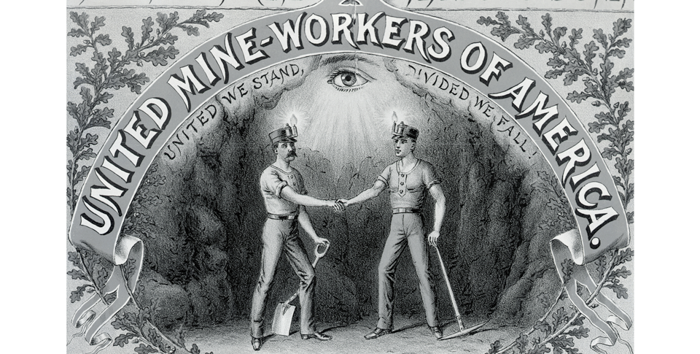
The Working Class Wins New Rights
This emblem comes from a United Mine Workers of America poster. Notice the motto beneath the name of the union. Analyze Images Why do you think the union chose that motto?

Slide 26
Quiz: Science and Technology Change Industry
How did Thomas Edison's invention of the light bulb affect industry?
A. Electric lights made it possible for factories to run after dark.
B. Having better lighting largely eliminated industrial accidents.
C. Bulb manufacturing became the biggest industry in the United States.
D. Brighter lights made people more productive so they worked fewer hours.

Slide 27
Quiz: Advances in Transportation and Communication
Which of the following had the greatest impact on transportation during the second Industrial Revolution?
A. the steam engine
B. the internal combustion engine
C. the Bessemer process
D. the dynamo

Slide 28
Quiz: The Rise of Big Business
Why did some business owners form corporations?
A. to regulate the free-enterprise system
B. to buy more stock in competitors' companies
C. to raise money to expand into different areas
D. to create a laissez-faire economy

Slide 29
Quiz: Better Medicine, Nutrition, and Health
Which factors caused the population of Europe to soar between 1800 and 1900?
A. Cities grew, and families had more children.
B. People bathed more and ate less.
C. The poor were treated at hospitals and survived surgeries.
D. Medicine advanced, and the death rate fell.

Slide 30
Quiz: City Life Changes
Which of the following changes to city life would be most likely to reduce the crime rate?
A. installing street lights
B. constructing sewer systems
C. erecting fine buildings
D. offering public entertainment

Slide 31
Quiz: The Working Class Wins New Rights
Why did some workers organize unions?
A. to support large corporations
B. to help women get factory jobs
C. to reduce work stoppages
D. to improve their working conditions

