Slide 1
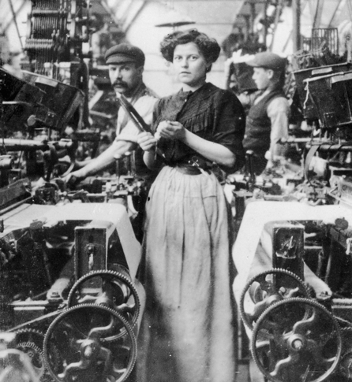
The Industrial Revolution (1750–1914)
Lesson 2 Social Impact of Industrialism

Slide 2
The Industrial Revolution (1750–1914)
Lesson 2 Social Impact of Industrialism
Learning Objectives
Outline the growth of industrial cities and the emergence of new social classes.
Describe the working conditions in factories and mines.
Analyze the benefits and challenges of industrialism.
Describe the ideas of Adam Smith and other thinkers regarding free enterprise.
Identify the origins and characteristics of socialism and communism.

Slide 3
The Industrial Revolution (1750–1914)
Lesson 2 Social Impact of Industrialism
Key Terms
urbanization
tenements
labor unions,
standard of living
social mobility
free market
Thomas Malthus
Jeremy Bentham
utilitarianism
socialism
means of production
Robert Owen
Karl Marx
communism
proletariat
social democracy

Slide 4
Industry Causes Urban Growth
The Industrial Revolution brought great riches to most of the entrepreneurs who helped set it in motion. It also provided employment for farmers and farmhands displaced by the changes in agriculture. But these jobs came with a heavy price. Millions of workers who crowded into the new factory towns endured dangerous working conditions, unsanitary and overcrowded housing, and unrelenting poverty.

Slide 5
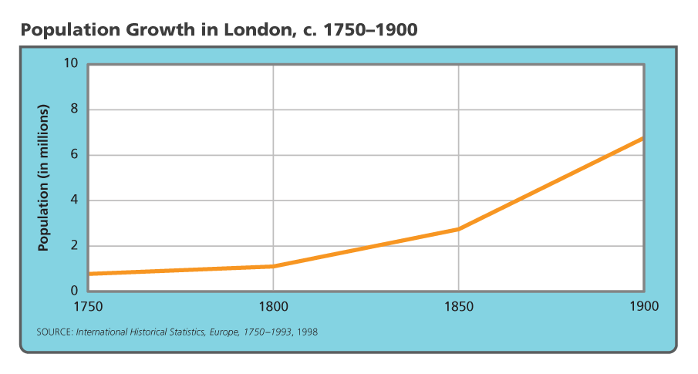
Industry Causes Urban Growth
The population of London, the capital of England, dramatically increased as factories sprung up. Analyze Graphs How many more people lived in London in 1900 than in 1750?

Slide 6
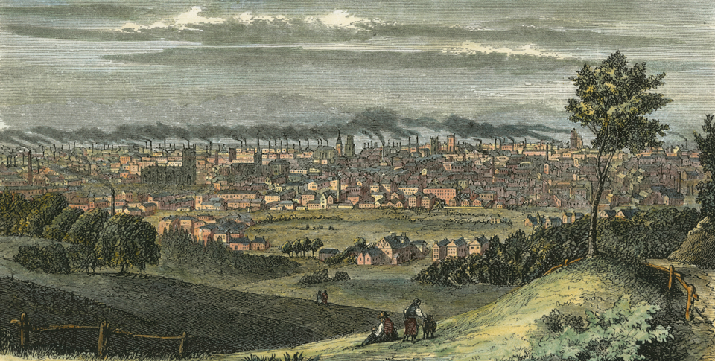
Industry Causes Urban Growth
This picture shows Manchester, England, around 1850. Fields still surround the crowded city, but by the 1900s, the city had become almost entirely industrialized.

Slide 7
The Rise of New Social Classes
The Industrial Revolution helped create both a new middle class and a new urban working class. The middle class included entrepreneurs and others who profited from the growth of industry and the rise of cities. The middle class enjoyed a comfortable lifestyle.

Slide 8
The Rise of New Social Classes
The Lives of the New Middle Class
The Lives of the Working Class
Workers' Protests
Methodists Help the Poor

Slide 9
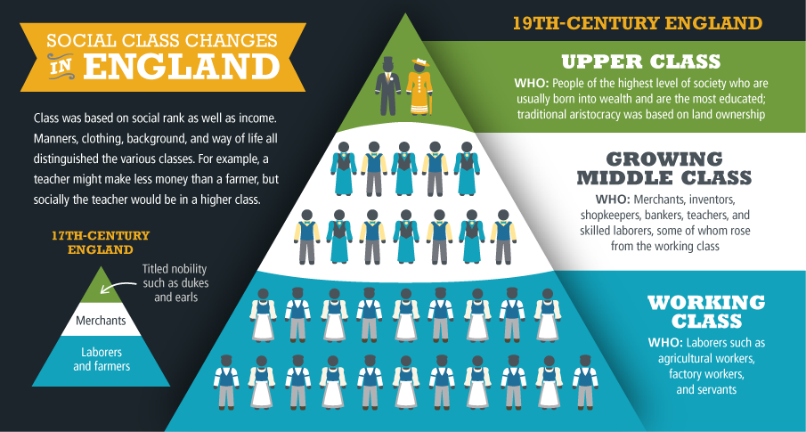
The Rise of New Social Classes
The expanding middle class included working-class people who found new opportunities because of industrialization. Analyze Charts Which class changed the least due to industrialization?

Slide 10
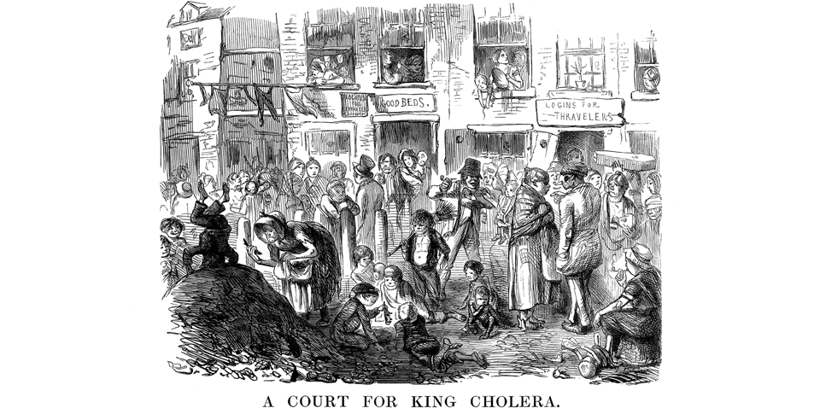
The Rise of New Social Classes
Diseases such as cholera were epidemic in urban environments, as sanitation services were limited or nonexistent. Analyze Political Cartoons How does this image show sanitation problems?

Slide 11
Harsh Conditions in Factories and Mines
The heart of the new industrial city was the factory. There, the technology of the machine age imposed a harsh and dangerous way of life on workers. The miners who supplied the coal and iron for the Industrial Age faced equally unsafe working conditions.

Slide 12
Harsh Conditions in Factories and Mines
Hazards of the Factory System
Dangers in the Mines
Children Perform Risky Work

Slide 13
Harsh Conditions in Factories and Mines
Men, women, and children worked side by side in many factories. Conditions in cotton mills could be cramped, as this photograph inside a mill in Lancashire shows.

Slide 14
Benefits of the Industrial Revolution
Since the 1800s, people have debated whether the Industrial Revolution was a blessing or a curse. The early Industrial Age brought great hardships and much misery. Although the first factories did provide jobs and wages to displaced farm workers, the conditions under which they labored were generally terrible. In time, however, reformers, along with labor unions, pushed for laws to improve working conditions in factories, mines, and other industries. Despite the negative aspects of industrialization, the new industrial world eventually brought many advantages.

Slide 15
Benefits of the Industrial Revolution
Better Standards of Living
New Worlds for Entrepreneurs
Social and Political Impact

Slide 16
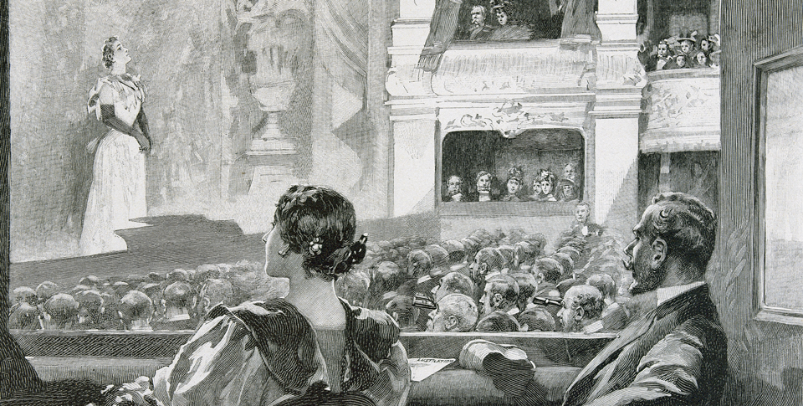
Benefits of the Industrial Revolution
Many middle-class families enjoyed newly afforded leisure activities, such as taking in a play.

Slide 17
Laissez-Faire Economics
Many thinkers and economists tried to understand the staggering changes taking place in the early Industrial Age. As heirs to the Enlightenment, these thinkers looked for natural laws to explain the world of business and economics. Their ideas would influence governments down to the present. Among the most influential schools of thought were laissez-faire economics, utilitarianism, and socialism.

Slide 18
Laissez-Faire Economics
Adam Smith and Laissez-Faire Economics
Malthus on Population Growth
Ricardo and the 'Iron Law of Wages'

Slide 19
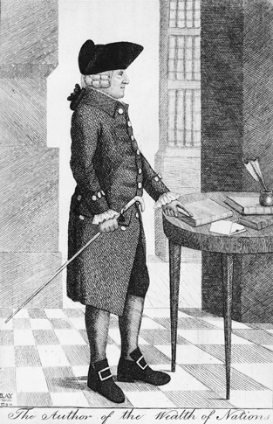
Laissez-Faire Economics
In The Wealth of Nations, Adam Smith proposed ideas about free market competition that are still applied today.

Slide 20
Utilitarians Support Limited Government
Other thinkers sought to modify laissez-faire doctrines to justify some government intervention. By 1800, British philosopher and economist Jeremy Bentham was advocating utilitarianism, or the idea that the goal of society should be “the greatest happiness for the greatest number” of its citizens. To Bentham, all laws or actions should be judged by their “utility.” In other words, did they provide more pleasure or happiness than pain? Bentham strongly supported individual freedom, which he believed guaranteed happiness. Still, he saw the need for government to become involved under certain circumstances.

Slide 21
Utilitarians Support Limited Government
Utilitarian Jeremy Bentham died in 1843. His will asked that he be preserved. Today, University College London still displays his skeleton, dressed in his clothes, topped by a wax reproduction of his head.

Slide 22
Socialist Thought Emerges
While the champions of laissez-faire economics favored the free market and individual rights, other thinkers focused on social inequality and what they claimed were the evils of industrial capitalism. They argued that industrialization had created an unjust gulf between rich and poor.

Slide 23
Socialist Thought Emerges
The Socialist Point of View
Owen and Utopian Socialism

Slide 24
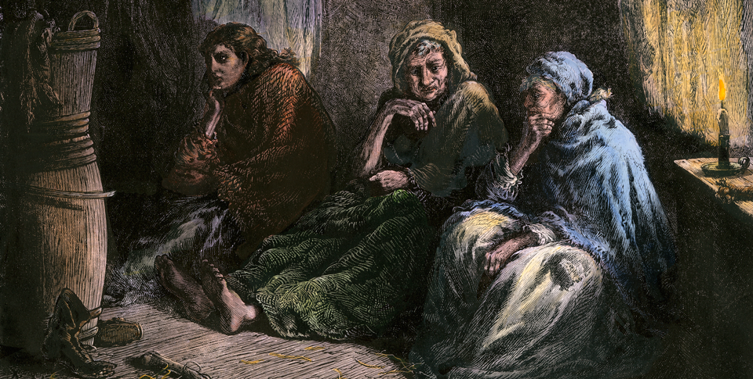
Socialist Thought Emerges
Widespread poverty, as shown here, motivated socialists to seek a more equitable economic system.

Slide 25
Marx and the Origins of Communism
In the 1840s, Karl Marx, a German philosopher, condemned the ideas of the Utopians as unrealistic idealism. He formulated a new theory, “scientific socialism,” which he claimed was based on a scientific study of history. He teamed up with another German socialist, Friedrich Engels, whose father owned a textile factory in England.

Slide 26
Marx and the Origins of Communism
Marxist Theory
Marxism Finds Support
Marxism Loses Its Appeal

Slide 27
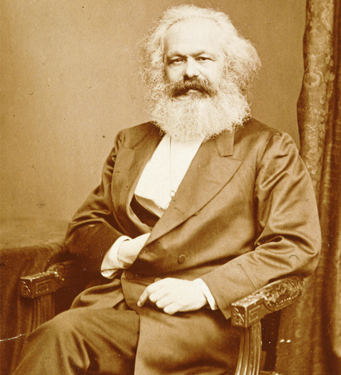
Marx and the Origins of Communism
Modern communism evolved from principles laid out by Karl Marx, shown here.

Slide 28
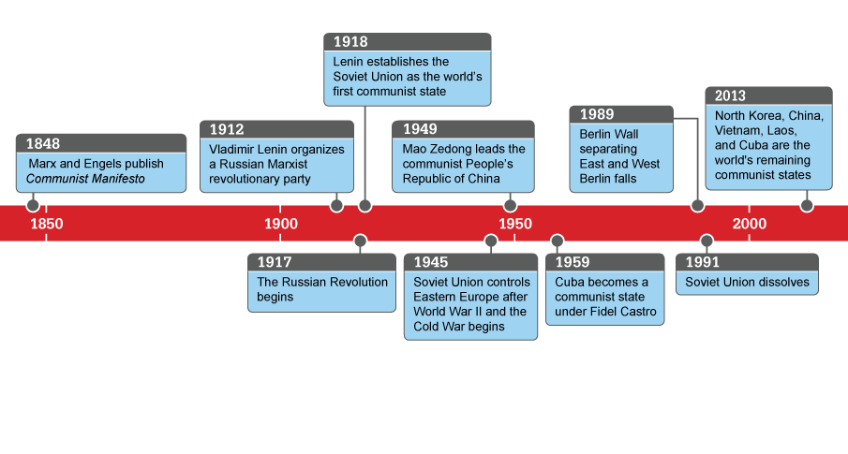
Marx and the Origins of Communism
Since Marx’s lifetime, communism has spread globally and then declined. Analyze Charts How much time elapsed between the Soviet Union's gaining control of Eastern Europe and the end of the Soviet Union?

Slide 29
Quiz: Industry Causes Urban Growth
Which of the following statements about population trends during the Industrial Revolution is most accurate?
A. Population decreased during the first stage of industrialization because of unsafe working conditions.
B. People left cities to move to farms because of improvements in farming from the agricultural revolution.
C. Towns built near coal and iron mines suffered a loss of population as workers left for factory jobs in cities.
D. Demand for labor in factories was one cause of the population shift toward urban areas.

Slide 30
Quiz: The Rise of New Social Classes
Which of the following supports the idea that the Industrial Revolution led to social change in Europe?
A. Lack of sewage systems in cities helped spread disease.
B. Entrepreneurs earned enough wealth to rise above the working class.
C. Labor unions were against the law during the early 1800s.
D. The poor lived mainly in neighborhoods with overcrowded buildings.

Slide 31
Quiz: Harsh Conditions in Factories and Mines
What statement best describes the lives of women who worked during the Industrial Revolution?
A. They worked 12 hours or more a day for half the pay of men, and they tended to the family and household when at home.
B. They avoided working in the mining industry because mines were too dangerous due to flooding, collapse, and explosions.
C. In textile mills, they changed spools and crawled under machinery to fix broken threads because of their small size and nimble fingers.
D. Employers made efforts to protect them from the most dangerous jobs in factories and mines and allowed them to work shorter days.

Slide 32
Quiz: Benefits of the Industrial Revolution
During the Industrial Revolution, how did economics drive political change?
A. Wealthy entrepreneurs entered the upper class and became members of Parliament.
B. The working class lost political power as they sought jobs in cities where they had no influence.
C. The growing middle class demanded more democracy, so voting rights gradually expanded.
D. The Luddites caused economic damage, which made authorities deprive workers of the vote.

Slide 33
Quiz: Laissez-Faire Economics
According to laissez-faire economists, what is the benefit of a free market?
A. Under a free market, the population would continue to boom, creating rapid economic growth.
B. A free market would encourage government economic policies to try to reduce poverty.
C. As production increased, the supply of goods would also increase and prices would drop so more people could afford goods.
D. In a free market, capitalists would reinvest in new businesses, which would create new jobs and raise the price of goods.

Slide 34
Quiz: Utilitarians Support Limited Government
The main focus of utilitarianism was
A. ensuring benefits for the growing middle class.
B. ensuring the greatest happiness through individual freedom for all classes.
C. providing help for the working class at the expense of the middle class.
D. preserving the privileges of the upper classes.

Slide 35
Quiz: Socialist Thought Emerges
Early socialism was most concerned with
A. sharing all property and means of production.
B. distinguishing the rich from the poor.
C. producing and distributing the most goods.
D. creating a Utopian society for all.

Slide 36
Quiz: Marx and the Origins of Communism
According to Marx, what would be the main characteristic of communism?
A. a community in which work was shared and property was owned in common
B. a classless society in which wealth and power were equally shared
C. a society in which the economy functioned without government interference
D. an economy in which private individuals owned the means of production

